Slide 1
FACULTY OF PHILOLOGY
ADAPTATION DAY
MA STUDIES –
ENGLISH PHILOLOGY
TEACHER TRAINING PROGRAMME
PART TIME

Slide 2
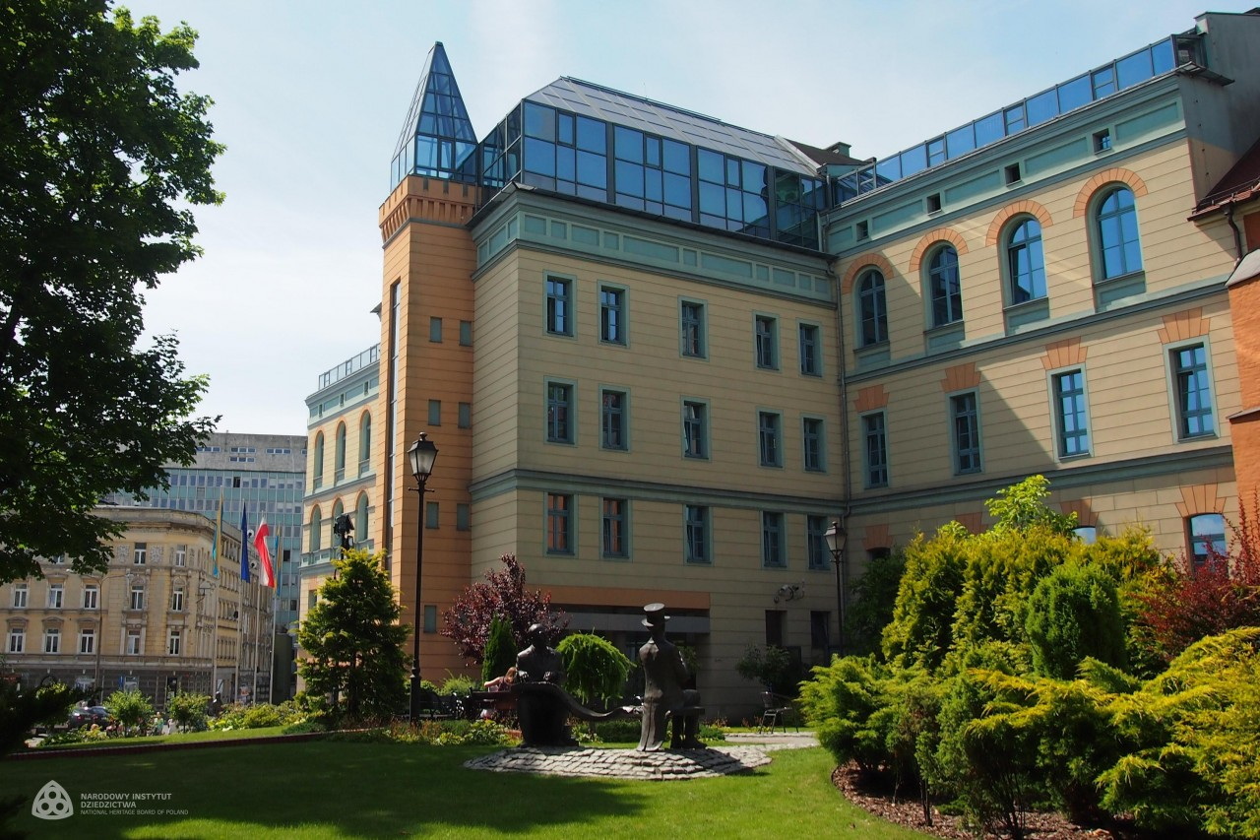

Slide 3
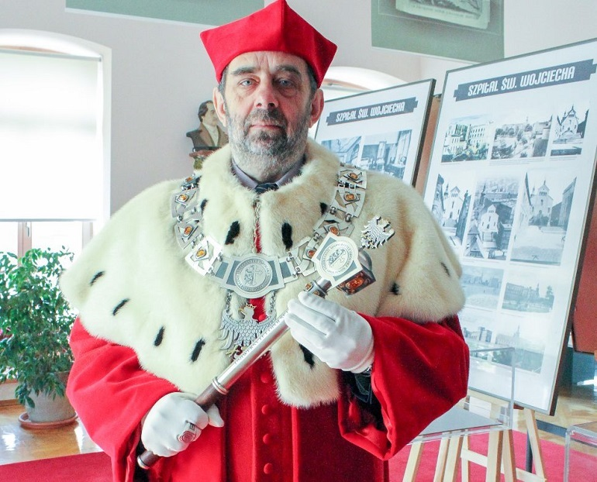
J.M. Rektor Uniwersytetu Opolskiego Prof. dr hab. Marek Masnyk

Slide 4
STUCTURE OF THE FACULTY
Institute of Linguistics
Headmaster: prof. J. Nocoń
Institute of Literary Studies
Headmaster: prof. R. Wolny
Dean (for didactics and student affairs)
dr Elżbieta Szymańska-Czaplak
Deputy Dean – coordinator of study programmes
dr M. Adams-Tukiendorf

Slide 5
Study Program Coordinator
dr Małgorzata Adams-Tukiendorf
Room 12 Collegium Maius – consultations
see USOS web for details

Slide 6
websites
www.wfil.uni.opole.pl
www.uni.opole.pl
http://kwestura.uni.opole.pl
http://epttp.wfil.uni.opole.pl/

Slide 7
USOSweb
Your email address to use nr_indeksu@student.uni.opole.pl (nr indeksu = nr albumu).
This is your logins to USOSweb https://usosweb.uni.opole.pl
Your password is the same
Centrum Informatyczne – in case of problems

Slide 8
Student ID
Log in to your USOS account
(you should already have both log in and password)
STUDENT folder
Payment 22 PLN (model FK)
Check out bank accounts of UO
Choose the account for student ID (download the form) – opłata za legitymację elektroniczną
When it is ready – you will be notified

Slide 9
SCHEDULE
http://epttp.wfil.uni.opole.pl/

Slide 10
Seminar group
Your MA supervisor:
2023-2025
dr Magdalena Szyszka

Slide 11
Teaching qualifications – in 3 semesters
Teaching English at primary school level 2 form 5-8
Teaching English at secondary school level 3
State Regulations – Ministry of Education & Science
Prepared to teach English to all age groups and all school types

Slide 12
ROOMS INFO
Rooms:
Collegium Maius (PL.KOPERNIKA 11)
or ONLINE

Slide 13
ONLINE TEACHING
Microsoft Teams Platform
See the instruction video on the website of IT Center = CENTRUM NOWOCZESNYCH TECHNOLOGII https://cnt.uni.opole.pl//
use your uni.opole.pl address and password to log in
Find your teacher or course – ask for invitation if you haven’t received one

Slide 14
Safety Training (4h)
one meeting - OBLIGATORY
07.10.2023 – IN POLISH
15:00-18:00
Room 306 CM
If you require an English version – contact the coordinator of the study programme

Slide 15
Library Training (2h)
English Library Collegium Maius room 011
one meeting - OBLIGATORY
14.10.22
09:45-11:45

Slide 16
UO Library
You need your student ID to become a member
Library of the Faculty of Philology
Collegium Maius (CM) sala 011 (podziemie)
Main Library
ul. Strzelców Bytomskich 2
Details during your Library training - OBLIGATORY

Slide 17
Academic year organisation
Check out your study programme website for details

Slide 18
ECTS
ECTS = European Credit Transfer System
(Europejski System Transferu Punktów)
You need to collect 30 points each semester
Some courses are variable – you need to enroll via USOSweb (University wide course - sem 2-4)
Some courses are elective but obligatory (foreign lg B2+ in sem 2 enroll via USOSweb )
USOS web – most important info re courses in the teaching programme

Slide 19
CONFIRMATION OF YOUR STUDENT STATUS
DEAN’S OFFICE
For extramural students on selected Saturdays – monitor the faculty’s website - http://wfil.uni.opole.pl/dziekanat/

Slide 20
Representatives
You need one person to represent the group at the dean’s office

Slide 21
Self-study C2 exam
mgr Stephen Branigan &
Dr Aleksandra Baryłowicz
Coordinate
The exam is at the end of 3rd semester

Slide 22
questions?

